Slide 1

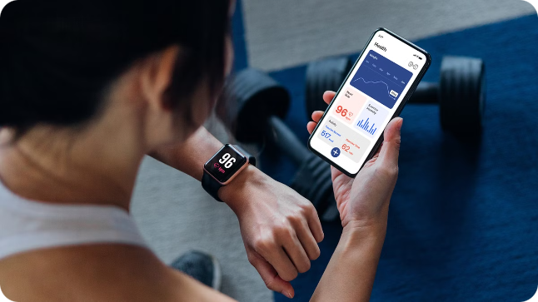

Introduction to Fitness Tracker
The Fitness Tracker scales the fitness level of a person using ML model called Ridge regression . You can input physical activity, sleep patterns, and it will predict caloric burn to achieve your wellness goals.
by Adal Rasheed

Slide 2

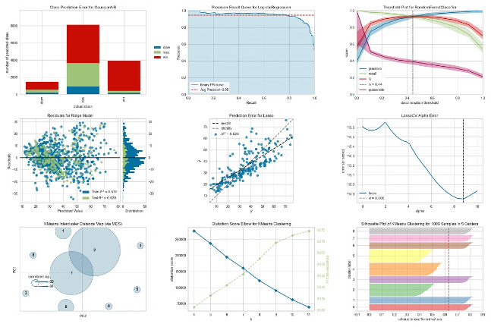
Overview of Machine Learning Model
Predictive Analytics
Personalized Insights
Our machine learning model leverages advanced algorithms to accurately predict calorie burn based on your fitness data.
The model adapts to your unique physiology and activity patterns, providing personalized recommendations to optimize your fitness routine.
Continuous Learning
As you use the Fitness Tracker, the model continuously learns and refines its predictions, ensuring accurate and reliable results over time.

Slide 3
Ridge Regression Technique
Robust Modeling
Regularization
Feature Selection
Ridge regression is a powerful machine learning technique that excels at handling complex, multivariate data, making it ideal for fitness tracking applications.
The technique employs regularization to prevent overfitting, ensuring the model generalizes well and provides reliable predictions.
Ridge regression automatically identifies the most influential features, such as physical activity and sleep hours, to optimize calorie burn predictions.

Slide 4

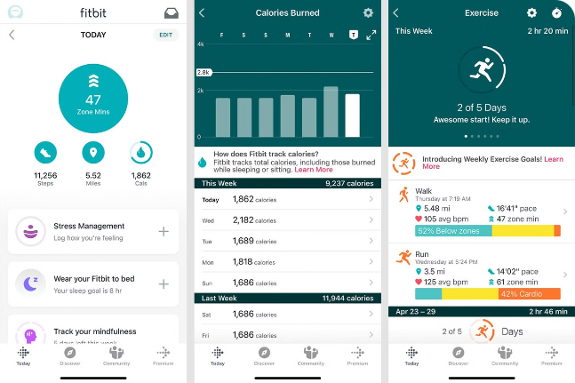
Key Features: Physical Activity and Sleep Hours
1
Physical Activity
2
Sleep Hours
The Fitness Tracker accurately monitors your daily steps, distance traveled, and intensity of physical activity to provide a comprehensive picture of your movement.
By tracking your sleep duration and quality, the Fitness Tracker helps you understand the impact of rest on your overall wellness and calorie burn.
3
Holistic Approach
The integration of physical activity and sleep data enables the machine learning model to make more accurate predictions about your caloric expenditure.

Slide 5

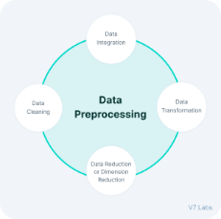
Data Collection and Preprocessing
Data Collection
Feature Engineering
The Fitness Tracker seamlessly gathers data from the device's sensors, tracking your movements and sleep patterns in real-time.
Relevant features are extracted and engineered from the raw data to optimize the machine learning model's performance in predicting calorie burn.
1
2
3
Data Cleaning
The data is carefully cleaned and preprocessed to remove any inconsistencies or outliers, ensuring the integrity of the information used for training the model.

Slide 6
Model Training and Evaluation
Training Process
Cross-Validation
Evaluation Metrics
The ridge regression model is trained on a large dataset of user fitness data, allowing it to learn the complex relationships between physical activity, sleep, and calorie burn.
Rigorous cross-validation techniques are employed to ensure the model's robustness and generalizability, minimizing the risk of overfitting.
The model's performance is evaluated using key metrics such as mean squared error and R-squared to ensure its accuracy in predicting calorie burn.

Slide 7

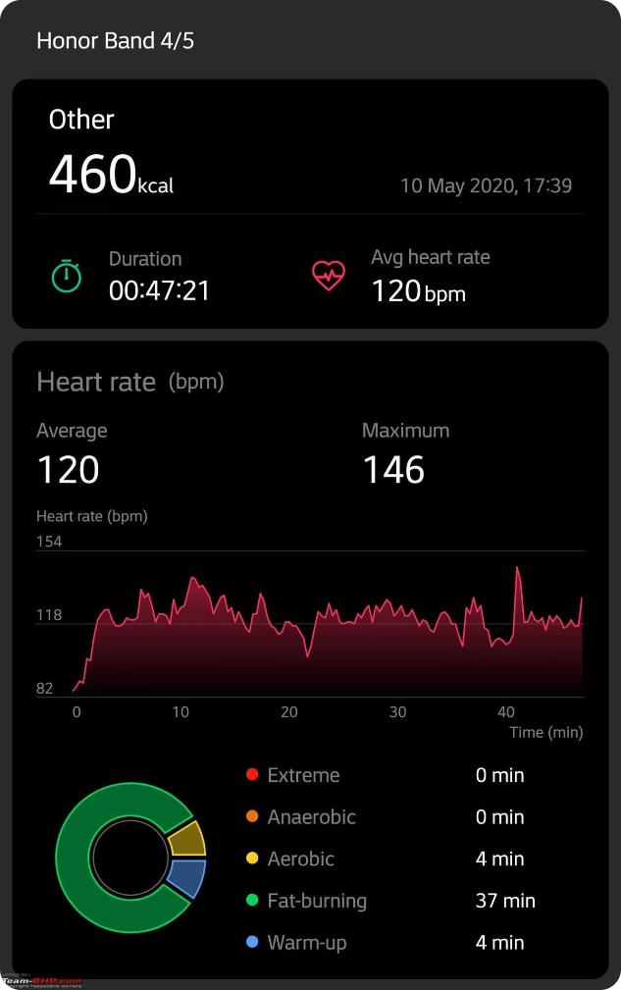



Predicting Calories Burned
Input Data
The Fitness Tracker collects your physical activity and sleep data in real-time.
Ridge Regression Model
The machine learning model processes the data and generates personalized predictions of your calorie burn.
Actionable Insights
The Fitness Tracker app provides you with accurate calorie burn estimates and tailored recommendations to help you achieve your fitness goals.

Slide 8

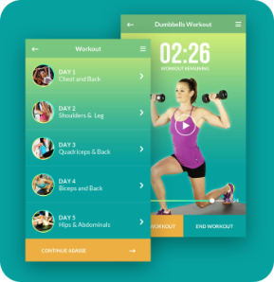
Thank you
Thank you for exploring the Fitness Tracker and its powerful machine learning capabilities. Let's embark on a journey towards a healthier, more active lifestyle together.

